Slide 1
AINT351: Machine Learning Lecture 4 Data modelling

Slide 2
2D Gaussian distribution
The joint Gaussian distribution for the vector y with mean μ and covariance matrix Σ is given by
Sometime written as
This equation says a lot!
Expanding the matrices and vectors leads to

Slide 3
2D Gaussian distribution
The covariance determinant and inverse terms can be written as
Therefore

Slide 4
2D independent Gaussian distribution
If the two components of the vector y are independent then
Therefore
Giving
Which is the product of two 1D Gaussians

Slide 5
1D Gaussian data with arbitrary μ and σ
To generate 1 iD Gaussian with μ = 0 and σ=1 we can use the Matlab randn function:
data = randn(1,1);
To change to sample drawn from a distribution with non-zero mean and non-unity standard deviation we need to scale by σ and hen add on μ
dataNew = data * σ + μ;
Note in 1D case
σ = √(var) ;
where var is the variance.
In the multidimensional case we have a covariance matrix not a scalar value

Slide 6
Generate a ND Gaussian distribution
Question: If we use randn(N,1) to draw N samples from a 1D distribution x₁ and use if again to draw another N samples from a 1D distribution x₂ and then build a 2D vector X, what is to covariance matrix of the 2D dataset X?
What are the covariance terms equal to here?
So how can we generate a joint Gaussian with covariance matrix ‘K’ and mean vector ‘meanVal’ ?

Slide 7
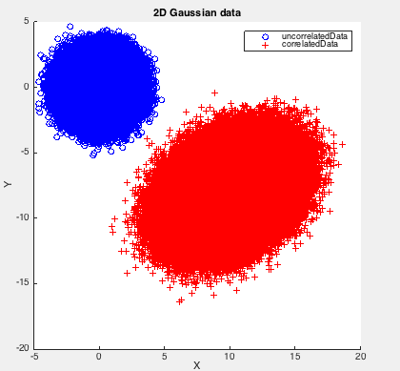
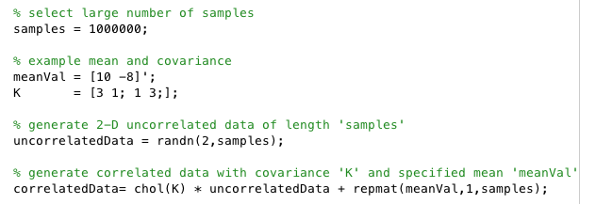
Generate correlated ND Gaussian data
To generate a random sample from a 2-dimensional joint Gaussian with covariance matrix ‘K’ and mean vector ‘meanVal’
First need to decompose the covariance matrix such that A^{T}A = K
We can use Cholesky decomposition to do this
Then multiply by A and add on meanVal:

Slide 8
AINT351: Machine Learning Lecture 4 Learning from data

Slide 9
Terminology for types of learning
Maximum likelihood (MP) learning
Does not assume a prior over the model parameters. Finds q parameter settings that maximizes the likelihood of the data P(D|θ)
Maximum a posteriori (MAP) learning
Assumes a prior over the model parameters P(θ). Finds a parameter settings that maximizes the posterior P(θ|D) α P(θ) P(D|θ)
Bayesian learning
Assumes a prior over the model parameters . Computes the posterior of the parameters P(θ|D)

Slide 10
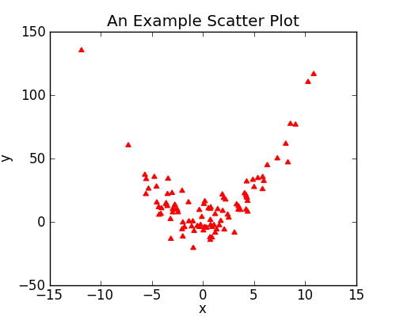
Simple statistical modeling
Assume we have a dataset Y= {y_{1, ….} y_{N}}
Each data point is a vector of D features y_{i}= {y_{i1, ….} y_{iD}}
The data points are I.I.D (independent and identically distributed)
One of the simplest forms of unsupervised learning is to model the mean and correlations between the D features of the data.
We can do so using the multivariate Gaussian model

Slide 11
Joint probability of a dataset
If two events y₁ and y₂ are independent we know that their joint probability is given by:
Similarly if data points in the dataset Y= {y_{1, ….} y_{N}} are I.I.D (independent and identically distributed) then, the likelihood of this dataset is

Slide 12
ML estimation of a Gaussian
Given the dataset Y= {y_{1, ….} y_{N}}, the likelihood of this dataset is
We wish to find the maximum likelihood of the dataset
⬄ maximize log likelihood (because mathematically its easier)

Slide 13
ML estimation of a Gaussian
Since
Substituting into the expression for likelihood
Therefore

Slide 14
Minimize -L
We wish to find the maximum likelihood, so minimize –L
We differentiate -L w.r.t to the parameters, leading to
sample mean
sample covariance

Slide 15

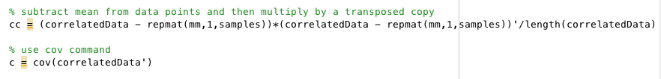
Calculate mean and covariance in Matlab
sample mean
sample covariance

Slide 16
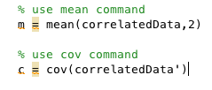
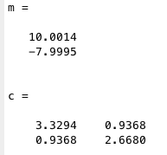
Why do we care about this?
Can now fit a single Gaussian to our dataset!
Later we will fit more sophisticated models, so understanding the simplest is very helpful!

Slide 17
Gaussian class-conditional model
The maximum likelihood fit of a Gaussian to some data is the Gaussian whose mean is equal to the data mean and whose covariance is equal to the sample covariance.
One very nice feature of this model is that the maximum likelihood parameters can be found in closed-form, so we don’t have to use iterative solutions
Seems easy.
And works surprisingly well.
But we can do even better with some simple regularization

Slide 18
Three limitations
We cannot account for higher order statistical structure in the data
These require nonlinear and hierarchical models
We need to deal with outliers
These require nonlinear and hierarchical models
The multivariate model uses D(D+1)/2 parameters.
If D is very large we need to use dimensionality reduction

Slide 19
AINT351: Machine Learning Lecture 4 Bayesian learning

Slide 20
Frequentist and Bayesian statistics
Frequentist approach
Probability is the limit of observed frequency as number of observations goes to infinity
Considers the model parameters to be fixed (but unknown), and calculates the probability of the data given those parameters
Bayesian approach
Probability is a “degree of confidence” that one attaches to an uncertain event
Requires a priori estimation of the model's likelihood, naturally incorporating prior knowledge

Slide 21
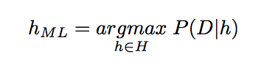
ML learning
P ( D|h ) is often called the likelihood of D given h
Here it is assumed that every hypothesis is equally probable a priori

Slide 22
ML estimation of coin flip probability
We have a coin and wish to estimate the outcome (head or tail) from observing a series of coin tosses. Λετ:
θ = probability of tossing a head
Therefore probability of tail= (1- θ )
Let h be the number of heads
Let n be the total number of trials.
Assume I.I.D ( coin doesn’t change between flips)
The likelihood of throwing h heads, independent or their order is given by:

Slide 23
ML estimation of coin flip probability
To find the ML estimate for θ we look at when dL/dθ = 0 :
Thus we should divide number of heads by total number of trials.
In a given experiment, the first flip may result in a tails
In this case ML estimate predicts zero probability of seeing heads!
But we know this cannot be the case!

Slide 24
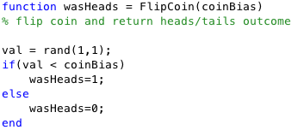
Flip coin in a Matlab simulation
Question: How can we simulate a coin flip in Matlab?

Slide 25
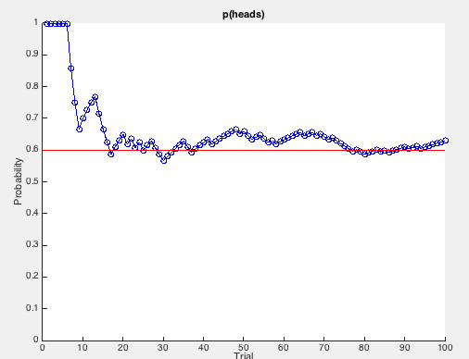
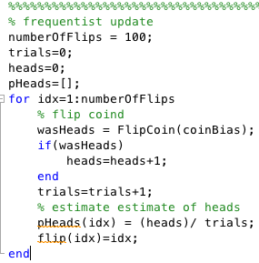
ML estimation of coin flip probability
Might get something like this
after 100 trials:
Use a Matlab simulation with coin bias = 0.6
If get several heads in row then can get inappropriate bias to heads
Can we do better than this?
Here we only have point estimate

Slide 26
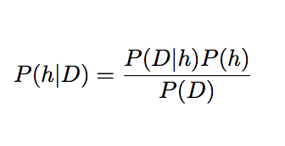
Remember Bayes theorem
Generally we want to find the most probable hypothesis given the training data
P ( h ) prior probability of h, represents our belief in what h should be
P ( D ) prior probability of D
P ( D|h ) probability of observing D given h holds
P ( h|D ) posterior probability of h after D has been observed

Slide 27
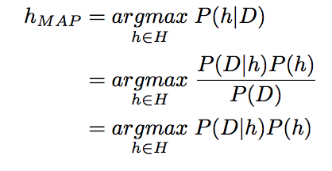
This leads to MAP learning
Really want the most probable hypothesis given the training data
P ( D ) can be dropped, because it is a constant and independent of h
NB: MAP and ML estimate are identical when the prior is uniformly distributed

Slide 28
MAP estimation of coin flip probability
Rather than estimating a single θ, we obtain a distribution over possible values of θ
Consider θ = probability of tossing a head as a random variable
We want to take our prior belief of what θ should be into account
Using Bayes theorem we can write the posterior is given by:
Where
is the same as expression from ML estimate with θ fixed to value x
And
Is the probability θ around x without seeing the data – the prior

Slide 29
How should be choose the prior?
Since prior is a distribution then:

Slide 30
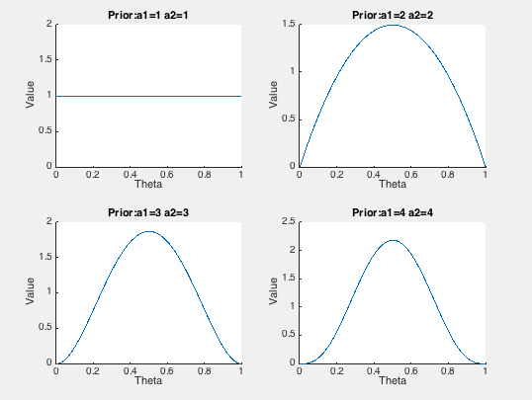
How should be choose the prior?
Want function that can represent the following kind of distributions
A suitable function for the prior is the Beta distribution since
It captures some of these important properties

Slide 31
Acknowledgements
Zoubin Ghahramani
Patrick Lam
Wikipedia
Sam Roweis
http://nucinkis-lab.cc.ic.ac.uk/HELM/helm_workbooks.html

